Slide 1
Tutorial 5 AVL, Tries
Original Slides By:
Jason Christopher (@jasonc21)
jason.christopher@u.nus.edu

Slide 2
Check In
Midterms in 1 week!

Slide 3
Tutorial Problems
AVL Trees and Tries

Slide 4
1. AVL Trees vs. Tries
Discuss the trade-offs of using AVL and Trie to store strings

Slide 5
1. AVL Trees vs. Tries
Discuss the trade-offs of using AVL and Trie to store strings
Time Complexity (Insert, Delete, Find)
For a word with length L in a collection of N words, AVL takes O(L log N), Trie takes O(L)

Slide 6
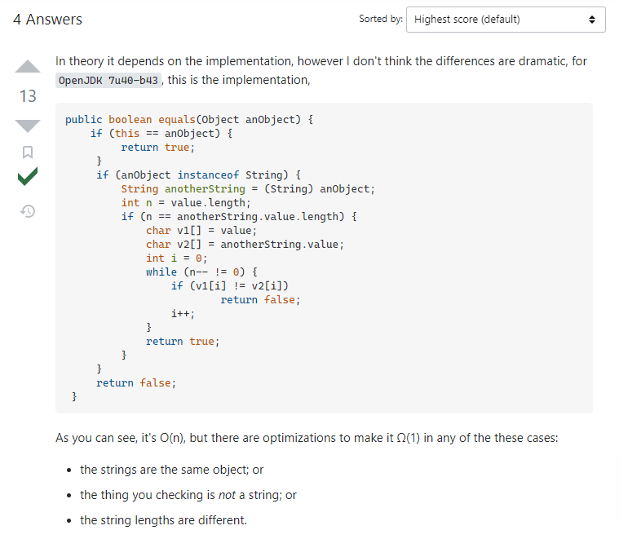
1. AVL Trees vs. Tries
For a word with length L in a collection of N words, AVL takes O(L log N), Trie takes O(L)
String::equals is an O(n) algorithm where n is the length of the string.

Slide 7
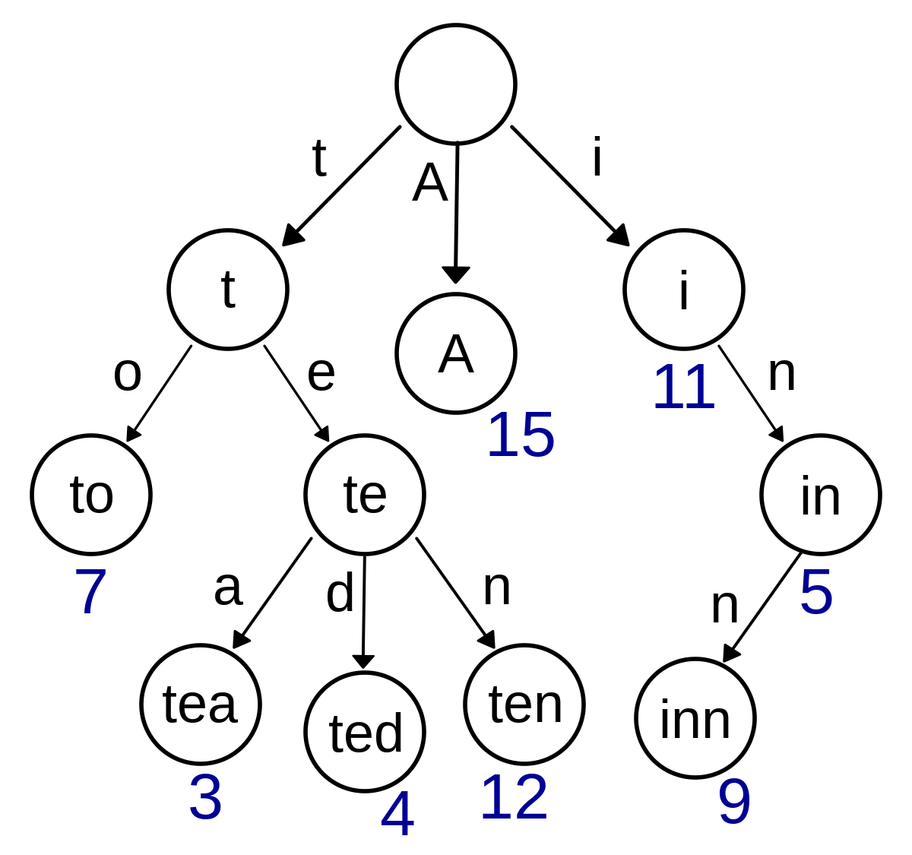
1. AVL Trees vs. Tries
Space Complexity
But Trie tends to have more overhead cost :O
Overhead cost comes from “linking” the nodes together. Trie has more links as compared to an AVL tree

Slide 8
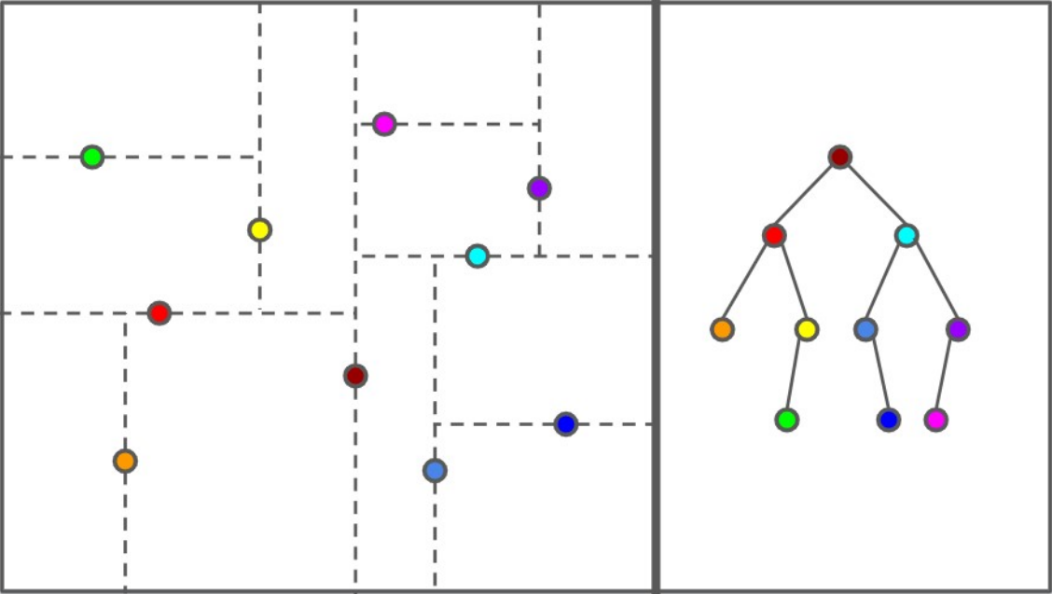
K-d trees

Slide 9
K-d trees

Slide 10
K-d trees

Slide 11
K-d trees

Slide 12
K-d trees

Slide 13
K-d trees

Slide 14
K-d trees

Slide 15
K-d trees

Slide 16
K-d trees
How to search?

Slide 17
K-d trees
Suppose I want to find the yellow node

Slide 18
K-d trees
Compare x coordinate
yellow < dark red

Slide 19
K-d trees
Compare x coordinate
yellow < dark red
Go left

Slide 20
K-d trees
Compare y coordinate
yellow > red

Slide 21
K-d trees
Compare y coordinate
yellow > red
Go right

Slide 22
K-d trees
Found yellow in the tree!

Slide 23
K-d trees
Start at the root. At each node, there is a horizontal or a vertical split.
If it is a horizontal split, then compare the x-coordinate to the split value, and branch left or right.
Similarly, If it is a vertical split, then compare the y-coordinate to the split value, and branch left or right.
The running time is just O(h), the height of the tree.

Slide 24
K-d trees
You are given an (unordered) array of points. What would be a good way to build a kd-tree? Think about what would keep the tree nicely balanced. What is the running time of the construction algorithm?

Slide 25
K-d trees
Basic Approach
Similar to a scapegoat tree:
Sort the data by x/y coordinate
Take the median
Recurse on the remaining partitions.

Slide 26
K-d trees
Basic Approach
Runtime? O(n log n) to sort at every level
T(n) = 2T(n / 2) + O(n log n)
= O(n log² n)

Slide 27
K-d trees
Better Approach
Instead of sorting at every level, we could either (1) choose a random split key, or (2) Use QuickSelect to find the Median
Partitioning time will only take O(n)
T(n) = 2T(n / 2) + O(n)
= O(n log n)

Slide 28
K-d trees
How would you find the element with the minimum (or maximum) x-coordinate in a kd-tree? How expensive can it be, if the tree is perfectly balanced?

Slide 29
K-d trees
If we are at a horizontal split?

Slide 30
K-d trees
If we are at a horizontal split?
Ez. Just move to the left

Slide 31
K-d trees
If we are at a vertical split?

Slide 32
K-d trees
If we are at a vertical split?
We have to consider both scenarios

Slide 33
K-d trees
Horizontal split → Recurse to the left
Vertical split → Recurse on both sides
e.g. if the root is at horizontal split:
T(n) = T(n / 2) + O(1)
(split horizontally)
T(n/2) = 2T(n/4) + O(1)
(split vertically)
T(n) = 2T(n/4) + O(1)

Slide 34

K-d trees
Recurrence Relation
T(n) = 2T(n/4) + O(1)
→ Depth of the recursion tree = log(n) / 2
Because of dividing n by 4 instead of 2
Runtime: Check all nodes in the recursion tree:
$$O\left(2^{depth}\right)$$

Slide 35

K-d trees
Recurrence Relation
T(n) = 2T(n/4) + O(1)
→ Depth of the recursion tree = log(n) / 2
Because of dividing n by 4 instead of 2
Runtime: Check all nodes in the recursion tree:
$$O\left(2^{\frac{\log{n}}{2}}\right)$$

Slide 36

K-d trees
Recurrence Relation
T(n) = 2T(n/4) + O(1)
→ Depth of the recursion tree = log(n) / 2
Because of dividing n by 4 instead of 2
Runtime: Check all nodes in the recursion tree:
$$O\left(2^{{\log{n}}^{\frac{1}{2}}}\right)$$

Slide 37

K-d trees
Recurrence Relation
T(n) = 2T(n/4) + O(1)
→ Depth of the recursion tree = log(n) / 2
Because of dividing n by 4 instead of 2
Runtime: Check all nodes in the recursion tree:
$$O\left(n^{\frac{1}{2}}\right)$$

Slide 38

K-d trees
Recurrence Relation
T(n) = 2T(n/4) + O(1)
→ Depth of the recursion tree = log(n) / 2
Because of dividing n by 4 instead of 2
Runtime: Check all nodes in the recursion tree:
$$O\left(\sqrt{n}\right)$$

Slide 39
3. Radix Trees
Build a data structure that supports the following operations:
insert(name, gender, count): adds a name of a given gender, with a count of how many babies have that name.
countName(name, gender): returns the number of babies with that name and gender.
countPrefix(prefix, gender): returns the number of babies with that prefix of their name and gender.
countBetween(begin, end, gender): returns the number of babies with names that are lexicographically after begin and before end that have the proper gender.

Slide 40
3. Radix Trees
Idea: Use a Trie!
“a”
Node stores the count of boys and girls for that prefix / name
Boys: _
Girls: _

Slide 41
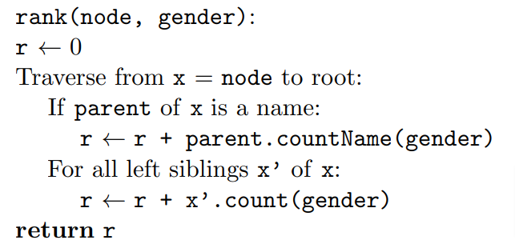
3. Radix Trees
Challenge: countBetween
Find rank(end, gender) – rank(begin, gender) – countName(end, gender)

Slide 42
Good luck for midterms!

